Slide 1
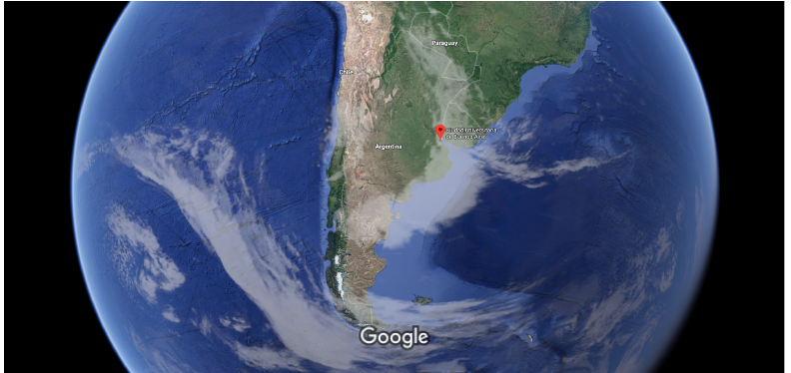
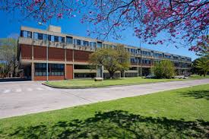


Slide 2

LaFEC: Computational Statistical Physics Lab
Nuclear Astrophysics
Prof. C.O.Dorso
Dr. G. Frank
Dr. P.Alcain
Lic.F. Pugliese
Prof. J. Lopez (UTEP)
Crowd Dynamics
Prof. C.O.Dorso
Dr. G. Frank
Lic. I. Sticco
Lic. F. Cornes
Eric Rozan
Josué Dionofrio
Vaccination / Opinions
Prof. C.O.Dorso
Prof. P. Balenzuela
Lic. S. Pinto
Lic.Facundo Sanchez.

Slide 3
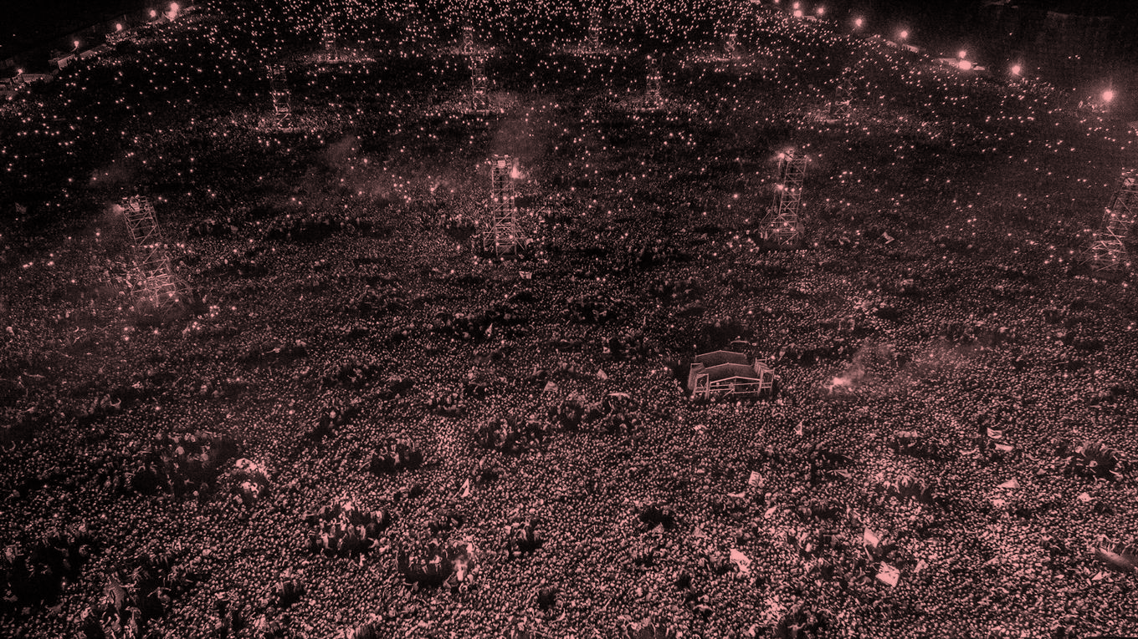
Epidemiology of panic
Diffusion of Fear in Crowds
Lic. Fernando E. Cornesª
Dr. Guillermo A. Frank^{b}
Dr. Claudio O. Dorso^{c}
ª Departamento de Física, FCEN-UBA.
^{b} UTN-FR Buenos Aires.
^{c} Instituto de Física de Buenos Aires, CONICET. FCEN-UBA.

Slide 4
The Talk
Introduction
Social Force Model (SFM)
The Force
Panic contagion model
Results
Turin (Italy)
Charlottesville (USA)
Conclucions
Outlook

Slide 5

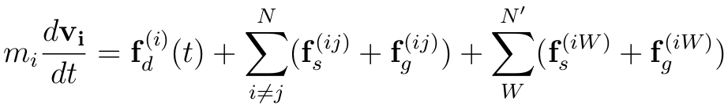
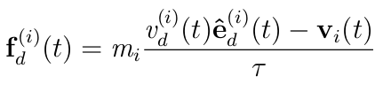


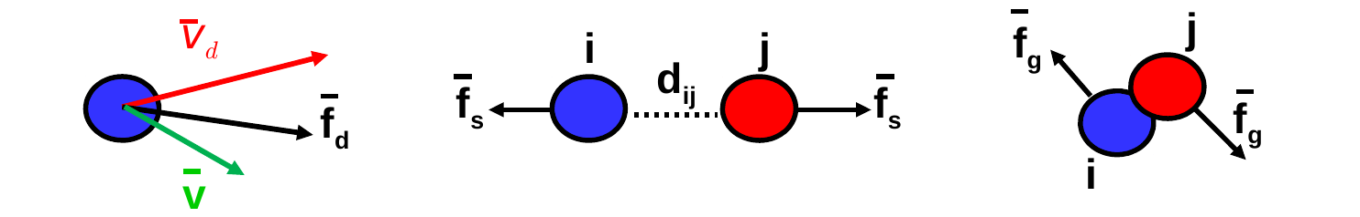
Introducción
SFM
Equation of motion
Desire force
Interaction with the walls
Acceleration
Inter individual Interaction
Desire force
Social Force
Granular Force

Slide 6
Introduction
225 pedestrians scaping from a 20mX20m room with a single exit (1.2m width)
Moving agents
“fallen agents”
*F. Cornes, G. Frank, and C. Dorso, Physica A: Statistical Mechanics and its Applications 484, 282 (2017).

Slide 7
Introduction
Previous research
Fundamenal Diagram in the context of the social Force model
I.M.Sticoo, G.Frank, F.E.Cornes &C.O.Dorso ; Safety Science 2019 (in press)
-Fear propagation and the evacuation dynamics
F.E. Cornes, G.Frank & C.O.DorsoSimulation Modeling, Practice and Theory 95 (2019) 112-133
Beyond the faster-is-slower effect.
(I. M. Sticco, F. E. Cornes, G. A. Frank, and C. O. Dorso (2017), Phys. Rev. E 96, 052303)
High pressures in room evacuation processes and a first approach to the dynamics around unconscious pedestrians.
(F. E. Cornes, G.A. Frank , C. O. Dorso (2017) Physica A 484: 282-298.)
Room evacuation through two contiguous exits.
(I. M. Sticco, G. A. Frank, S. Cerrotta, C. O. Dorso (2016) Physica A 474: 172-185.)
Panic evacuation of single pedestrians and couples.
(G.A. Frank, C. O. Dorso (2016) Int. J. Modern Physics C 27:08.)
Evacuation under limited visibility.
(G.A. Frank, C. O. Dorso (2015) Int. J. Modern Physics 26:01.)
Room evacuation in the presence of an obstacle.
(G.A. Frank, C. O. Dorso (2011) Physica A 390: 11. 2135-2145.)
Morphological and dynamical aspects of the room evacuation process
D.Parisi and C.O.Dorso Physica A Vol. 385 (2007) 343 – 355.
The role of panic in the room evacuation process.
D.Parisi y C.O.Dorso, Int. Jour. Of Modern Physics C 17 (2006) 419
Microscopic Dynamics of Pedrestian Evacuation;
D.R.Parisi and C.O.Dorso, Physica A (2005) 354, 606-618

Slide 8
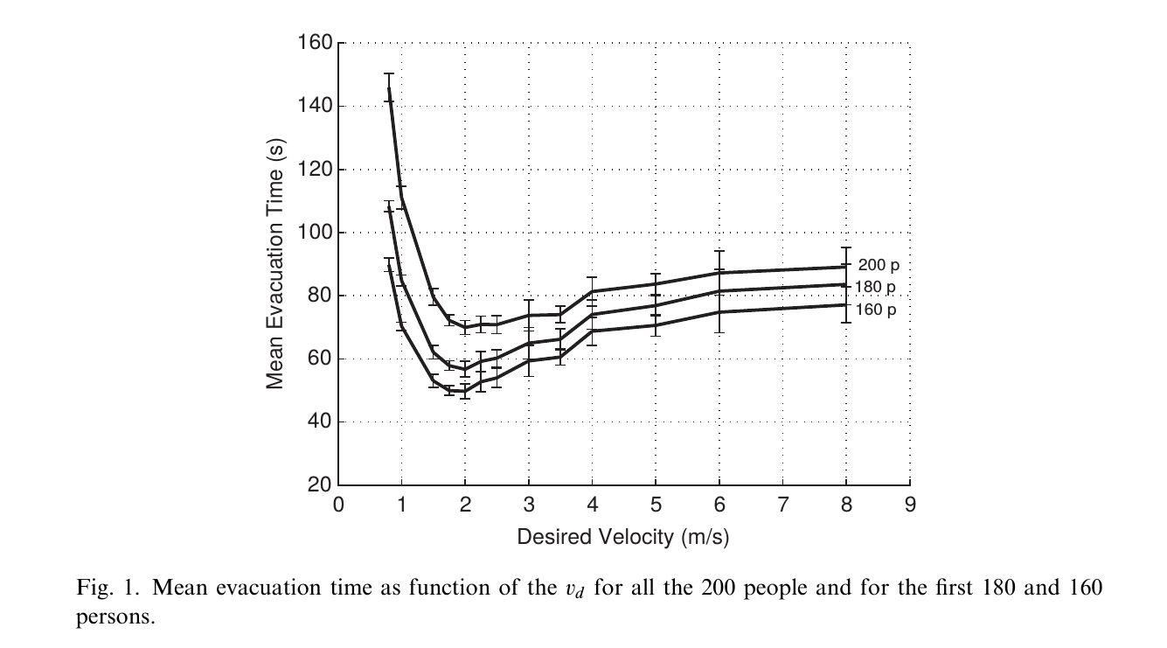
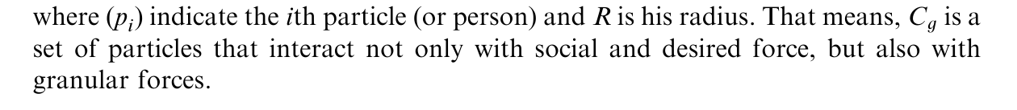
Mean Evacuation Time

Slide 9
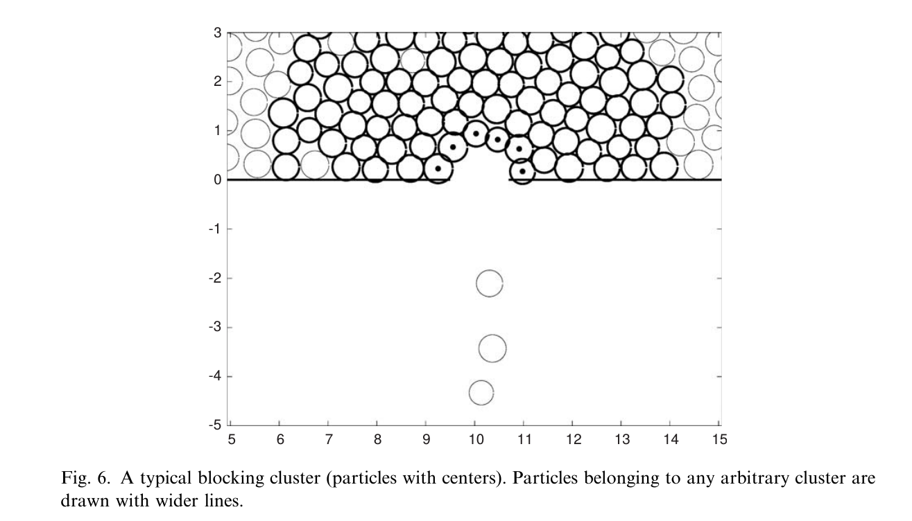
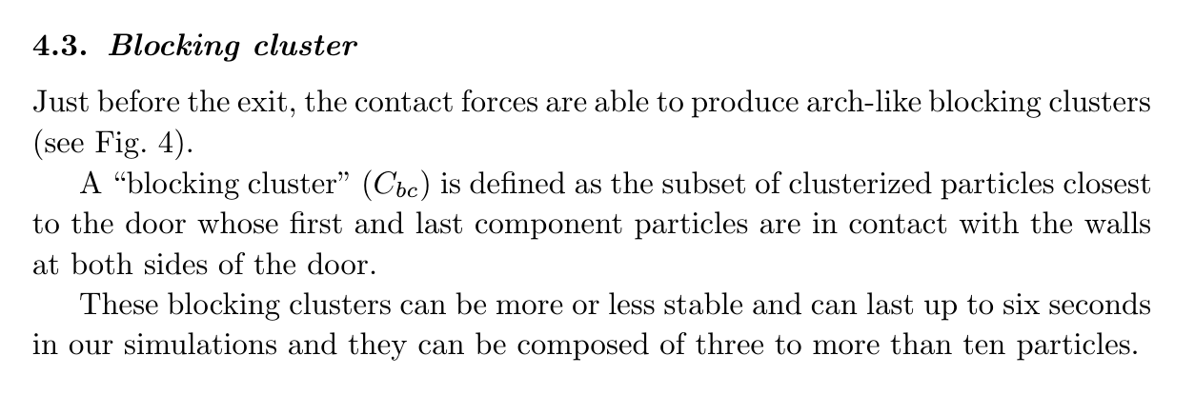
Blocking clusters

Slide 10
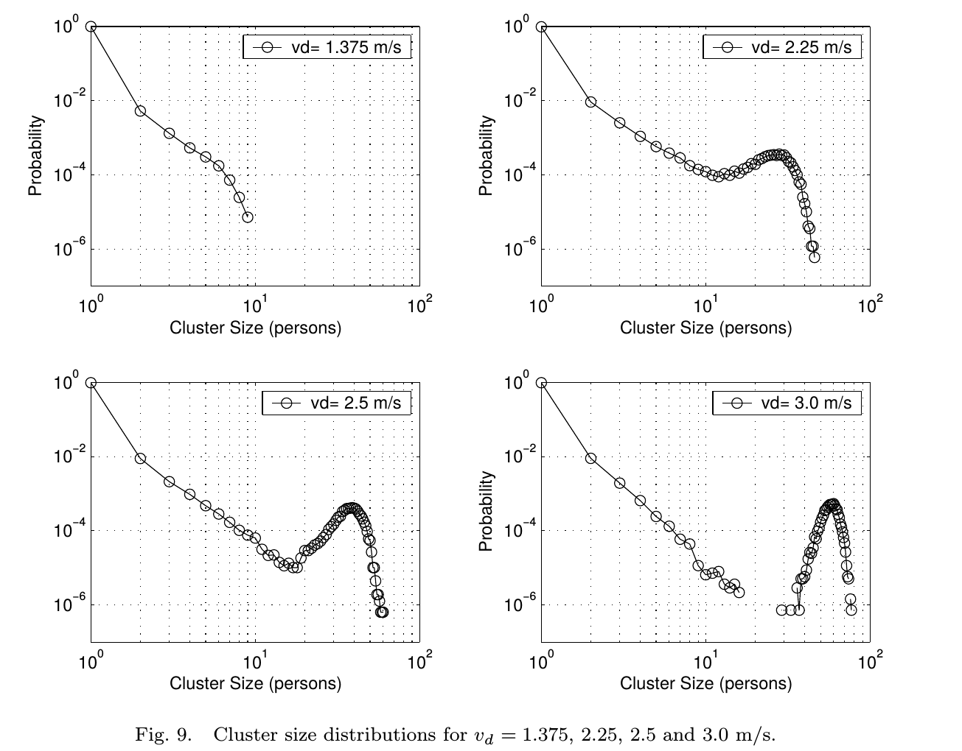
Cluster size distributions

Slide 11
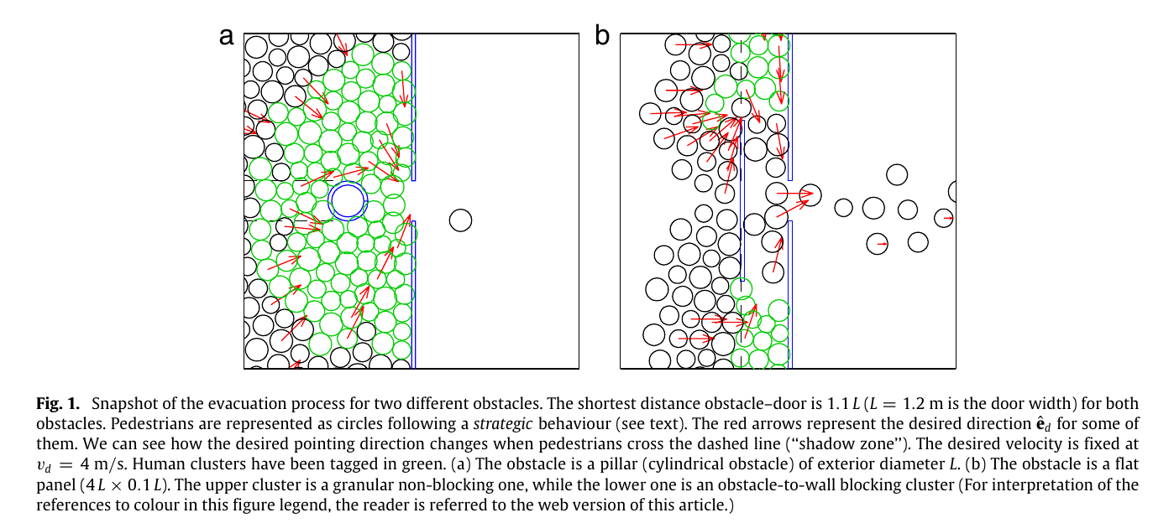
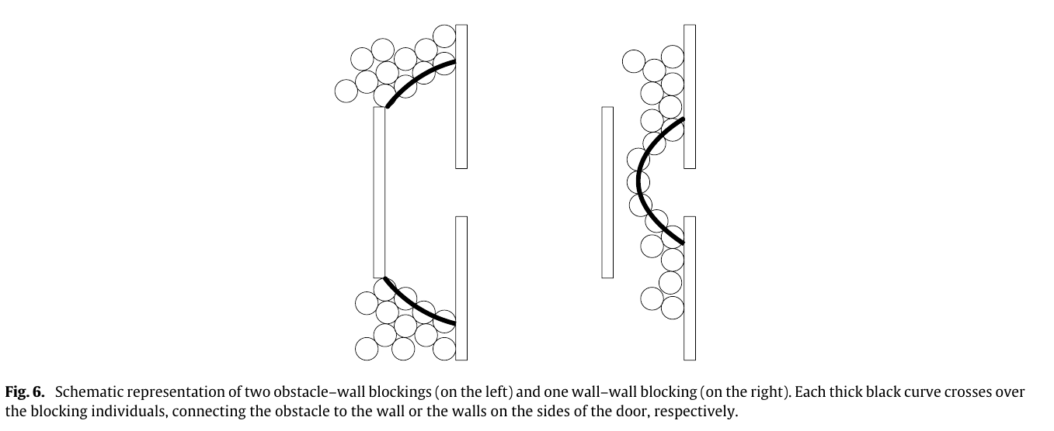
Panel
Pilar

Slide 12
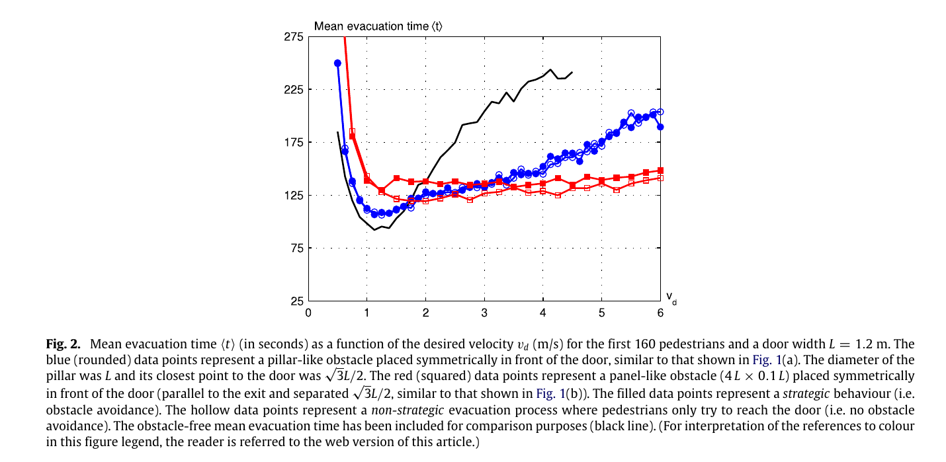
“Pilar”
“Panel”

Slide 13
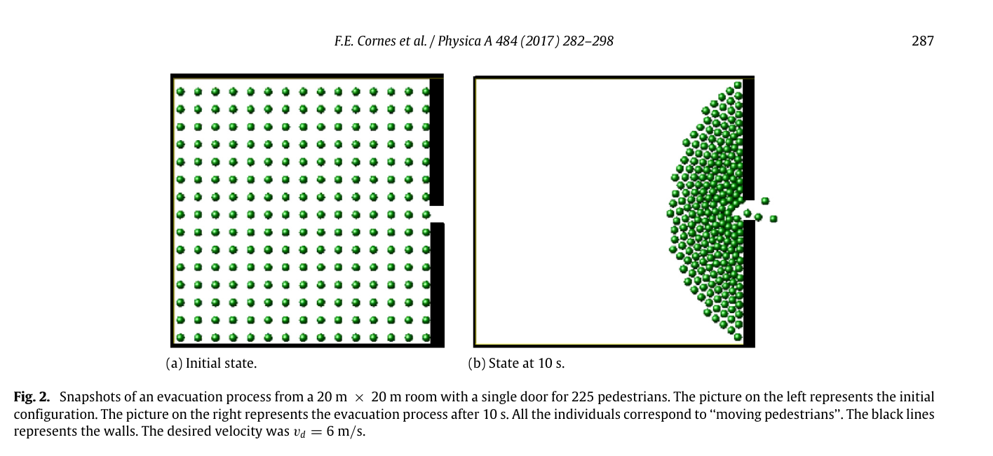
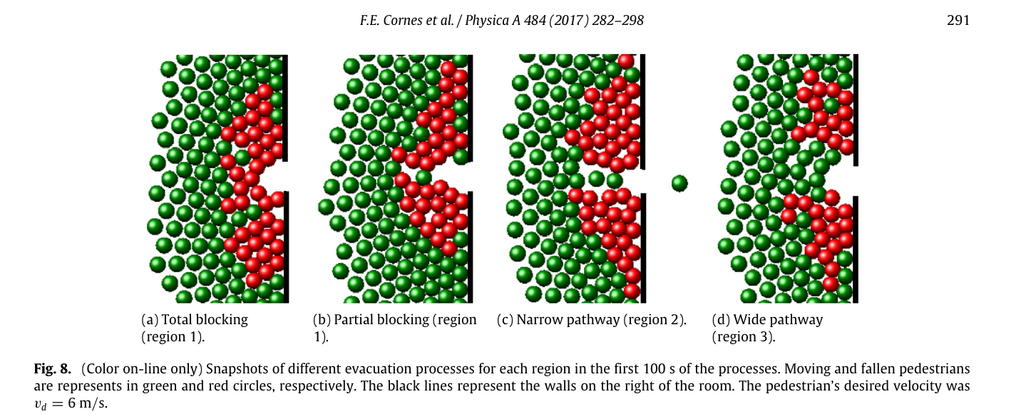

Slide 14
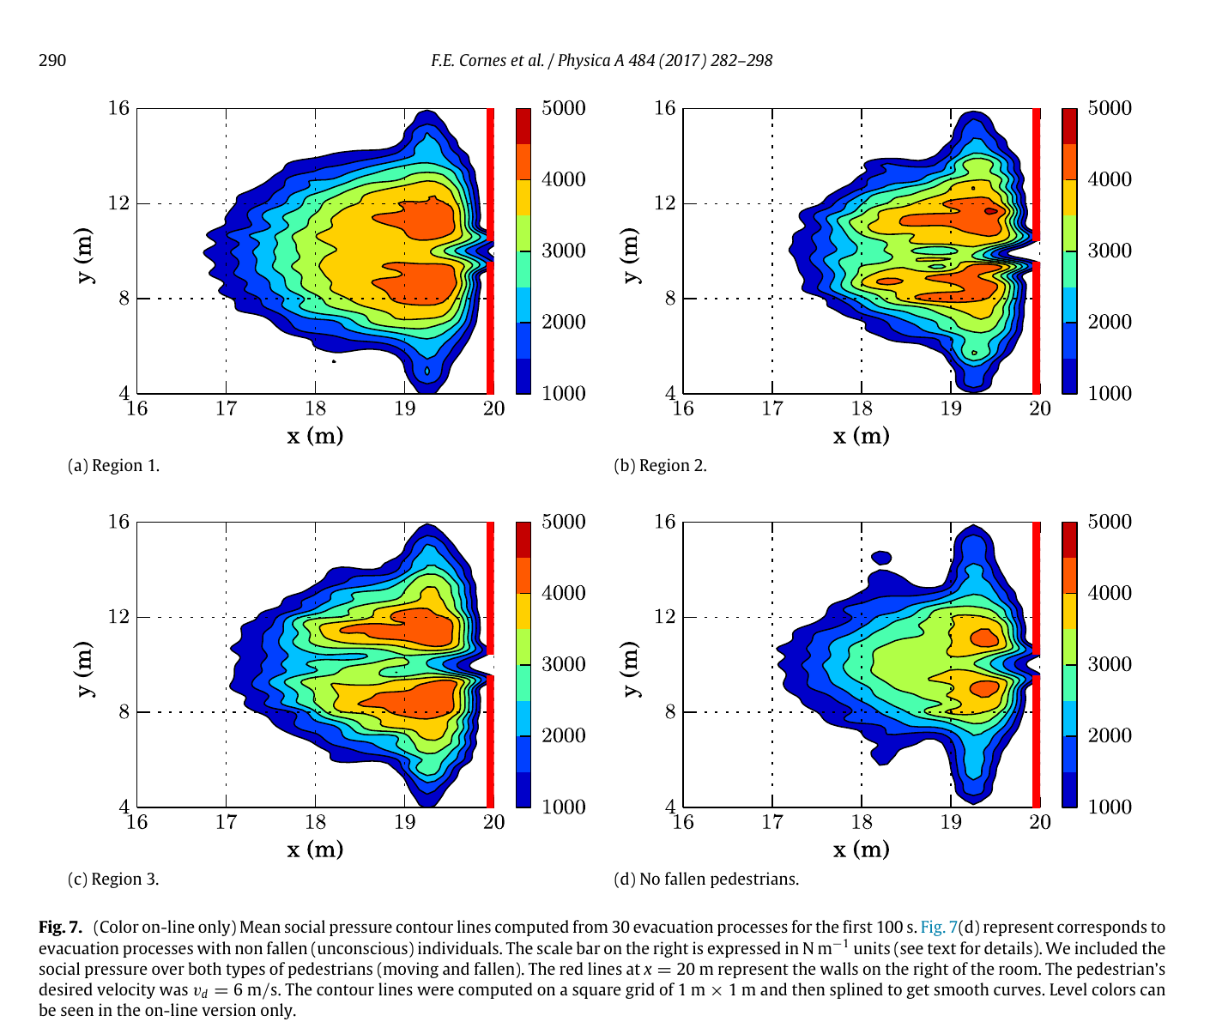

Slide 15
Introduction
(Paris, 15th November, 2015)
During a tribute to the victims of terrorist attack

Slide 16
Introducción
Multitudes en estado de pánico (Turin, 3 de Junio de 2017)
Gathering to watch soccer match at Piazza San Carlo.
A stampede took place after an individual claimed that a bomb was in the place
More than 1000 hurt individuals due to a sudden panicked rush

Slide 17
Introducción
Introduction
Charlottesville, August 12th, 2017
A man rammed a car into anti-racist protesters in Virginia.
One fatal victim plus 19 injured ones
A man rammed a car into anti-racist protesters in Virginia
Individuals close to the colliding car relax must faster than pedestrians far away

Slide 18
The Talk
Introducción
Social Force Model (SFM)
Forces
Panic contagion
Results
Turin (Italy)
Charlottesville (USA)
Conclusions
Future work

Slide 19
Introducción
SFM
Equation of motion
Desire force
Interaction with the walls
Acceleration
Inter individual Interaction
Desire force
Social Force
Granular Force

Slide 20
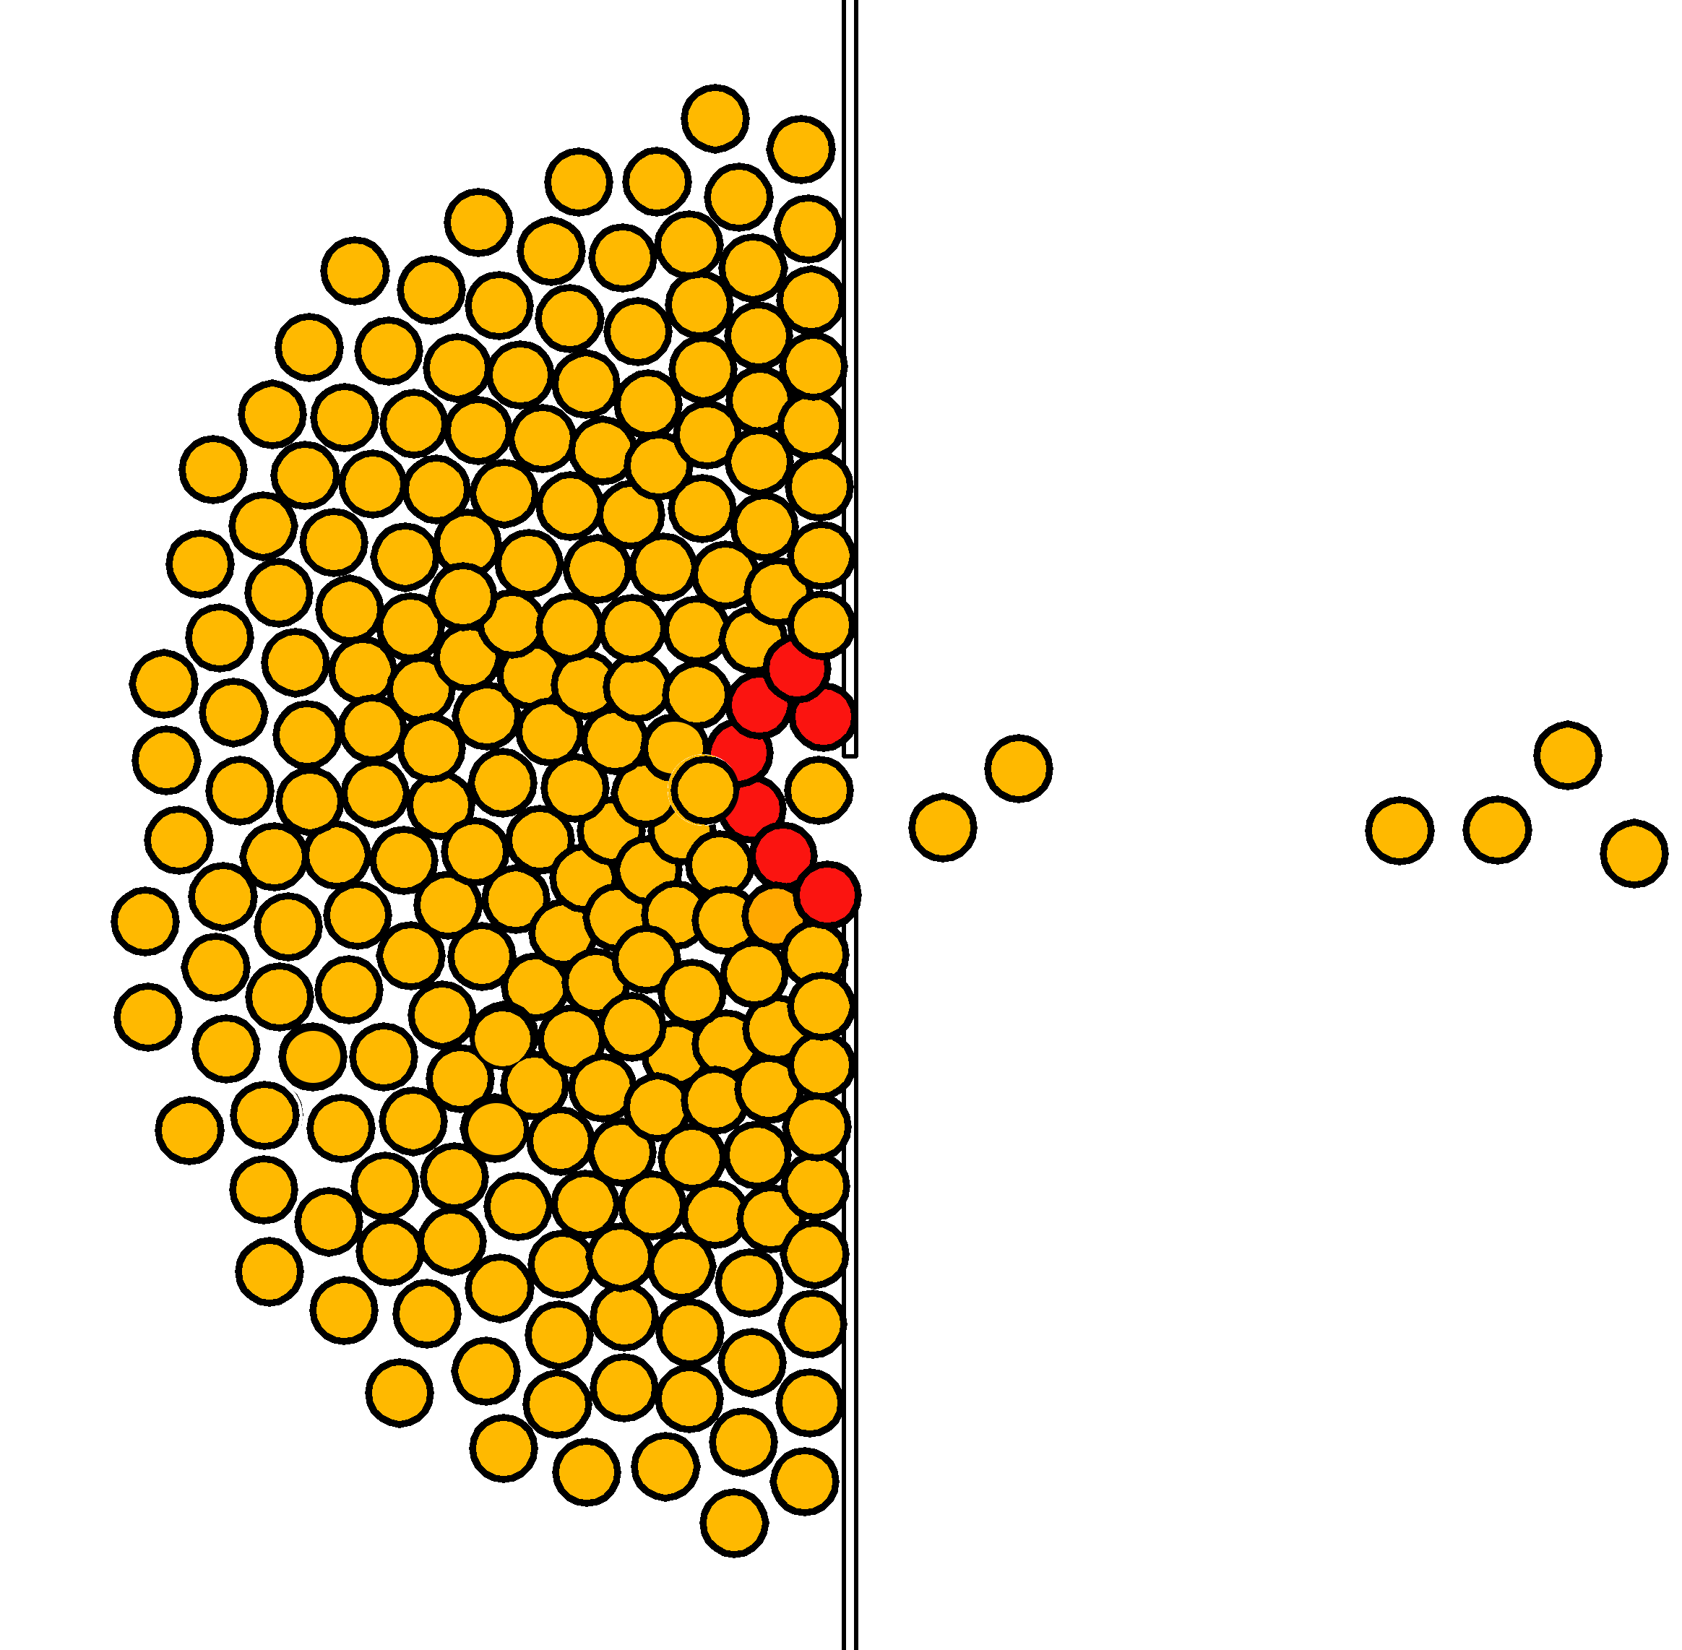
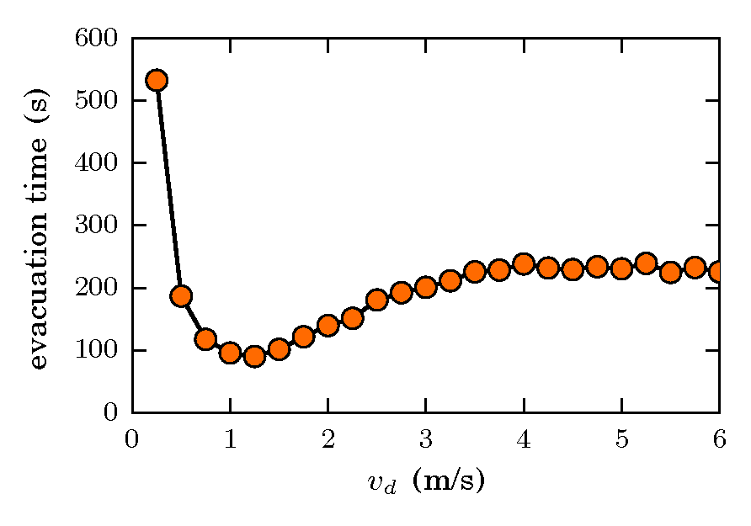
Introducción
SFM
“faster is slower” effect
Above a given threshold, the faster the individual try to move the longer the evacuation time is

Slide 21
The talk
Introducción
Social force model (SFM)
Forces
Panic contagion
Results
Turin (Italia)
Charlottesville (Estados Unidos)
Conclusions
Future work

Slide 22
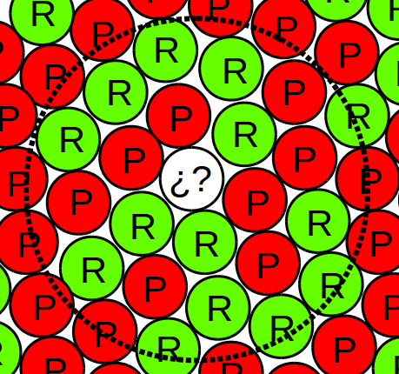

Introducción
Panic contagion
Efectividad de contagio
Individual Susceptibility [0,∞)
Number of
Neighbors in panic
Total number
Of neighbors
Contagion efficiency
Panicked
Relaxed
Contagion radius

Slide 23

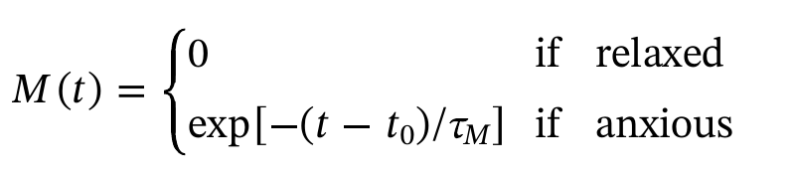
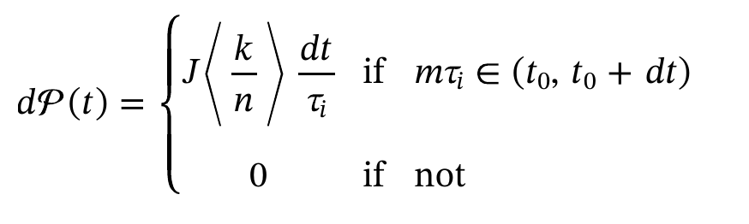
Introducción
Panic contagion
Efectividad de contagio

Slide 24


c
Introducción
Modelo de contagio de pánico
Panic contagion
Panic decay
A individual relaxes in the absence of stimulus
Relaxed
Panicked (τ=10s)
Panicked (τ=1.44s)
No information
Informed
Relaxation time (experimental)
Anxiety variation with time (v_{d}).
* Emotional Contagion Model for Group Evacuation Simulation, Informatica 41, 169–182 (2017)

Slide 25
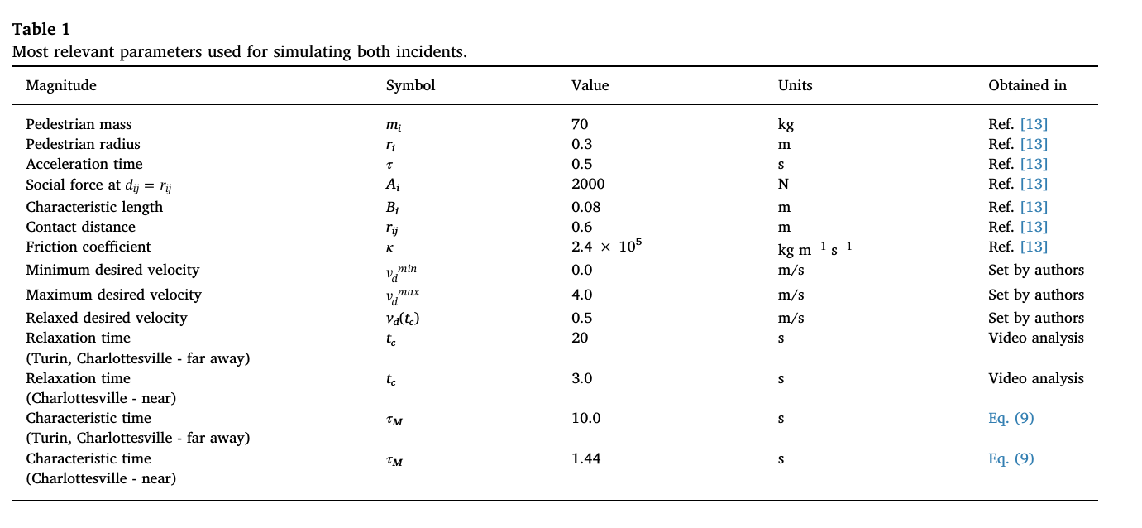
Panic contagion

Slide 26
The talk
Introduction
Social Force Model
Forces
Panic contagion
Results
Turin (Italy)
Charlottesville (USA)
Conclusions
Future work

Slide 27
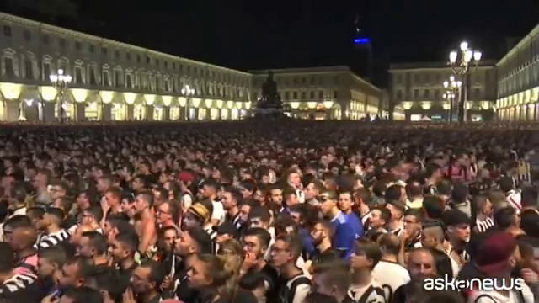

Introducción
Results (Turin)
Analysis
Relaxed
Panicked
The multitude watching the match
(screen on the left)
Panic propagation
(J^{(exp)} = 0.1 ± 0.055)
Some individuals remain relaxed
Some panicked individuals are surrounded by relaxed pedestrians

Slide 28
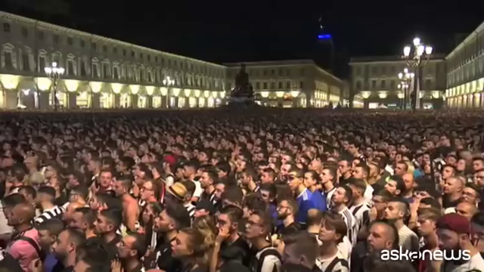
Introducción
Resultados (Turin)
Configuración inicial
screen
The multitude watching the match
(screen on the left)
Simulation
Simulation : 925 individuals in a 21 m x 21 m area
Density : 2 individuals per square meter.

Slide 29
Introducción
Results (Turin)
Number of panicked individuals (first 15 seconds)
Average of 60 sim
J^{(exp)} = 0.1 ± 0.055
For J larger than J = 0.04, most of the individuals fall into panic.
Number of panicked individuals shows weak dependence on (r_{o}).

Slide 30
Introducción
Results (Turin)
Relaxed
Video y simulación
Panicked
High susceptibilidad
(J = 0.1)
J^{(exp)} = 0.1 ± 0.055
The multitude, in the simulation, develops a geometry similar to the real case.

Slide 31
Introducción
Resultados (Turin)
Relaxed
Simulations
Panicked
Low susceptibility
(J = 0.01)
Medium susceptibility
(J = 0.02)

Slide 32
The talk
Introduction
Social Force Model
Forces
Panic contagion
Results
Turin (Italy)
Charlottesville (USA)
Conclusions
Future work

Slide 33
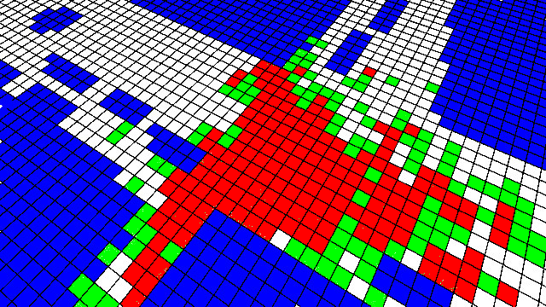
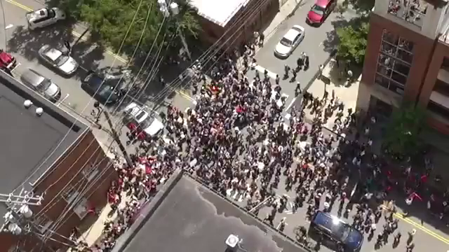
Introducción
Results (Charlottesville)
Analysis
Pixelated Image
(first video frame)
The multitude
Green cells ⟹ one individual per cells
Red cells⟹ more than one individual per cell
Cell size : 1.5 m x 1.5 m

Slide 34
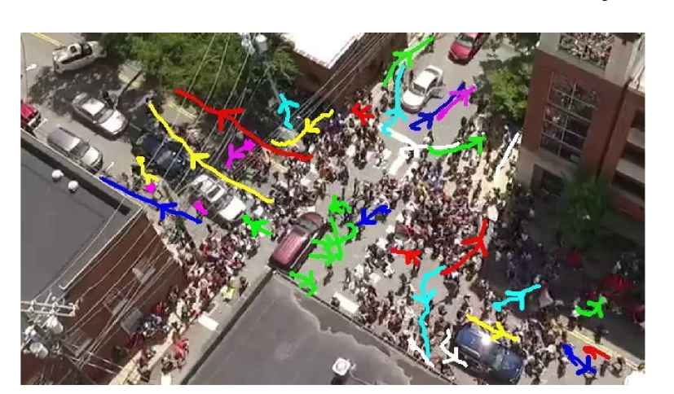
Introducción
Results (Charlottesville)
Configuración inicial

Slide 35
Introducción
Results (Charlottesville)
15 m
5 m
13 m
5 m
The multitude
8 m
Simulation
Simulation with 600 agents.
The car was represented by 21 “spheres” moving “up” along the street

Slide 36
Introducción
Results (Charlottesville)
Analysis
Pixelated Image
(first video frame)
Average density
(90 simulations)
Green cells ⟹ one individual per cell
Red cells⟹ more than one individual per cell
Cell size : 1.5 m x 1.5 m

Slide 37
Introducción
Results (Charlottesville)
Number of panicked individuals (first 15 seconds)
90 simulations
Close
Far away
All
Close
Far away
All
The curve with white simbols resembles the Turin case
If J < 0.02, Panic propagates around the car only
If J > 0.06, Panic propagates all over the multitude

Slide 38
Introducción
Results (Charlottesville)
relaxed
Video & simulation
panicked
Individuos recuperados
high susceptibility
(J = 0.1)

Slide 39
Introducción
Results (Charlottesville)
relaxed
Simulations
In panic
Individuos recuperados
Low susceptibility
(J = 0.01)
Intermediate Susceptibility
(J = 0.028)
Panicked individuals are close to the car only

Slide 40
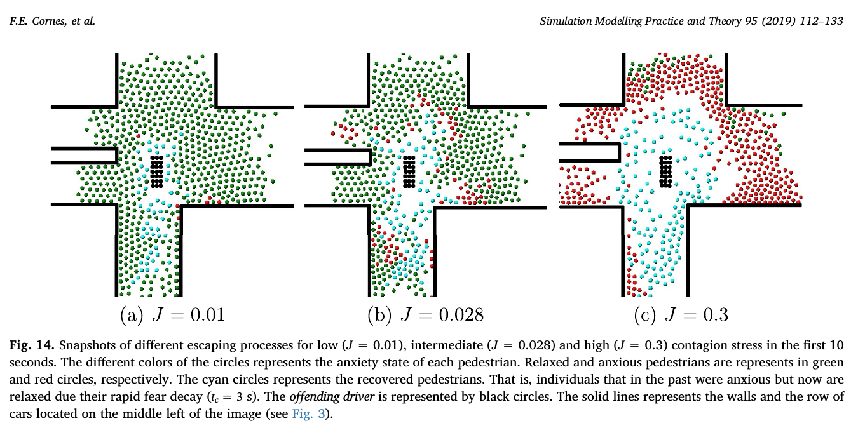
Results (Charlottesville)

Slide 41
The talk
Introduction
Social Force Model
Forces
Panic contagion
Results
Turin (Italy)
Charlottesville (USA)
Conclusions
Future work

Slide 42
Conclusiones
We analyzed two “real” cases from the study of the videos only.
We propose a model of: panic contagion and decay.
There are two kinds of behaviors according to the amount of information the individuals have.
The obtained results are compatible with the real behavior of multitudes (for high susceptibility)

Slide 43
Trabajo a futuro
We are studying large gatherings like the annual pilgrimage to Mecca
We are interested in the competition between individualistic and collectivistic (solidarity) behavior
Motion of multitudes in complex geometries
Evacuation of a city

Slide 44

¡Muchas gracias!
Claudio O. Dorso and
Jorge A. López
Lawrence Berkeley Lab, 1988

Slide 45
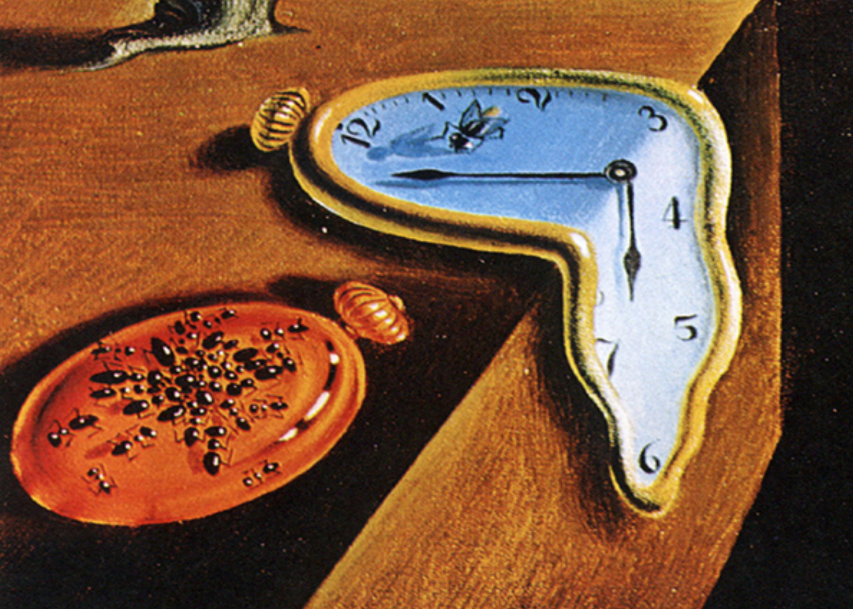
Time is up,Thank you

Slide 46
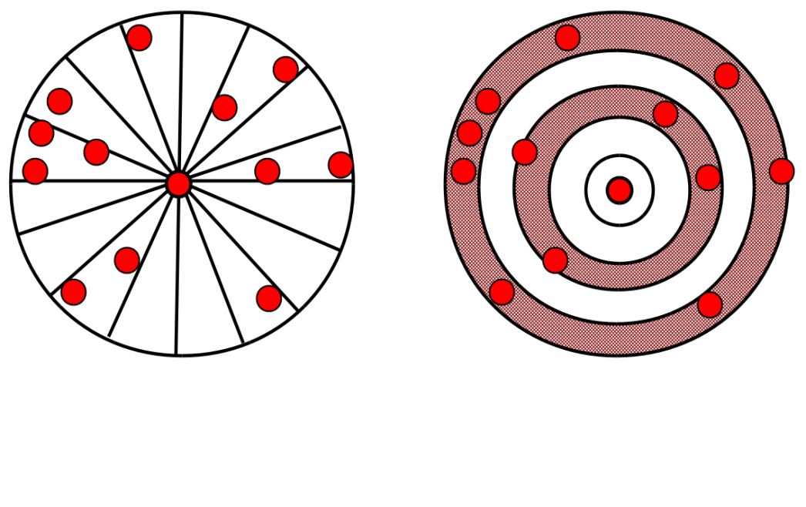
Introducción
Resultados (Turin)
Distribución espacial de los individuos en pánico (60 procesos)
Bins radiales
Bins circulares
Número de bins ocupados por uno o más individuos en pánico
Cada bin radial (angular) mide 12º (1 m).
A medida que la susceptibilidad (J) aumenta, los bins se ocupan más temprano (mayor velocidad de propagación del pánico).

Slide 47
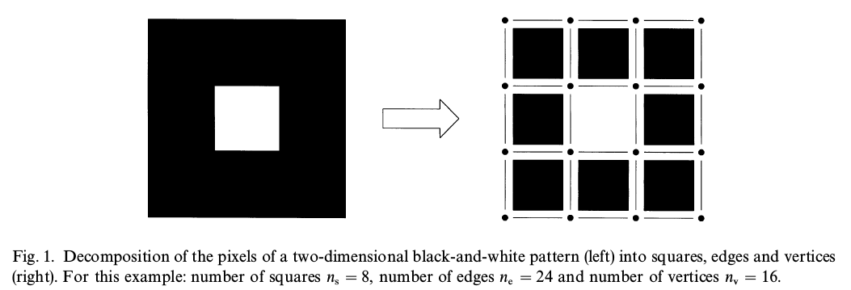
Introducción
Resultados (Charlottesville)
Funcionales de Minkowski
Número de Euler: número de regiones conexas (celdas negras) menos cantidad de “agujeros” (celda blanca)
Área
Perímetro

Slide 48
Introducción
Resultados (Charlottesville)
Funcionales de Minkowski (90 procesos)
Área
Perímetro
Los funcionales permiten asociarle una susceptibilidad de J = 0.3 a la multitud de Charlottesville.

